Slide 1




BG6
PVN
2026 PVN FME Q1工作報告
部門: (PVN)第六事業群-製造及營運管理中心-越南製造處-PVN1廠-FME部-自動化課
姓名: Ethan Nguyen
職等: 19
日期: 2026/03/15
FME
BG6 PVN

Slide 2
BG6
PVN
Q1 –2026 Work Results
Time | Work Result
2025 Q4 | 1. Training new AOI project (R30, CCX350 & CCX400, ICX8100, USW-Flew8, USW-Flex5)
 | 2. Make sure the good performance operation of the AOI machine( above 95%)
 | 3. Operate new AOI device
2026 Q1 | 1. Complete setting and new project USW-Flew8, USW-Flew5 on production line
 | 2. Testing new AOI project ICX8100
 | 3. Running AOI machine on production line
FME
BG6 PVN

Slide 3
BG6
PVN
Q3 –2025 Work Results
1. Set up AOI equipment in line
Set up 4K, 4J, 4P, 5S, 5P
• Set up AOI device , camera, sfis network,...
• Testing program with sample.
• Improve error catching, vision
• Debug the program
• Fix program error
Set up all part of AOI machine 4P, 5S(ICX8100), 5P(USW-Flex8)
• Setup camera to check all part of devices.
• Setting camera, setup layout.
• Test computer.
• Inference server.
• AOI working process.
FME
BG6 PVN

Slide 4
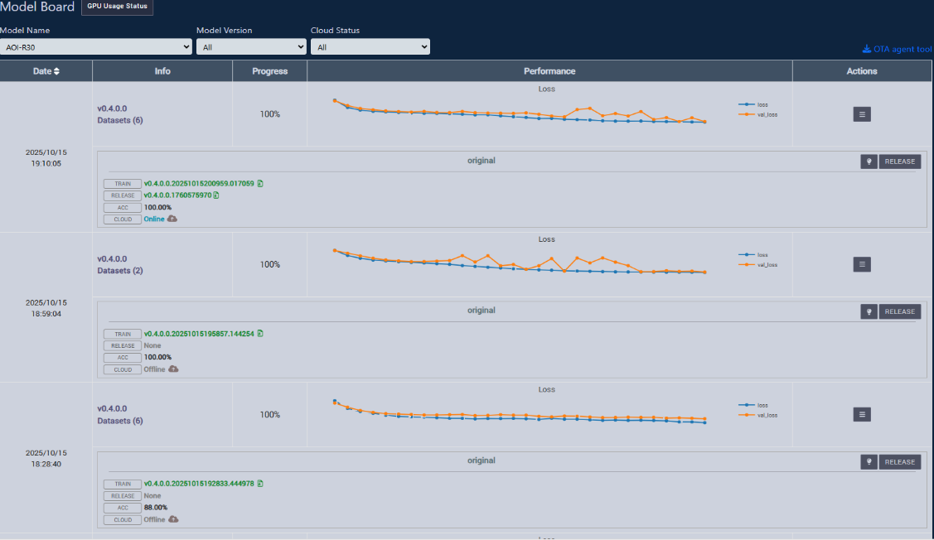
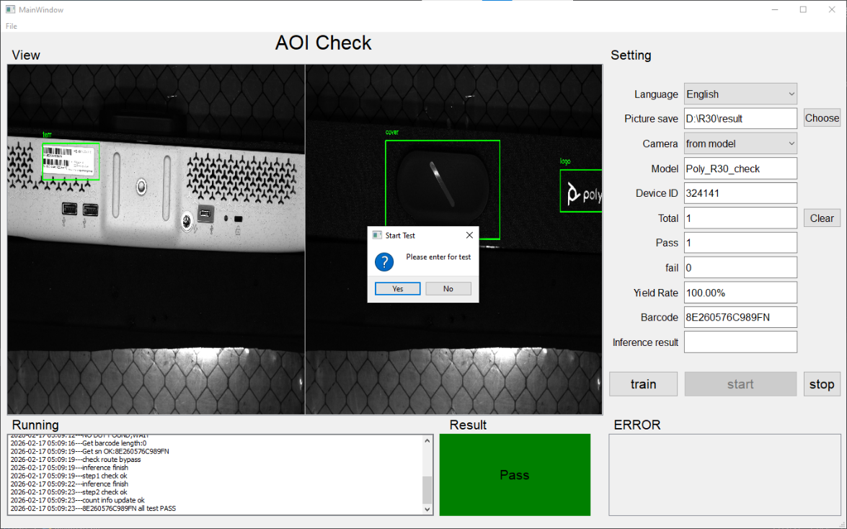
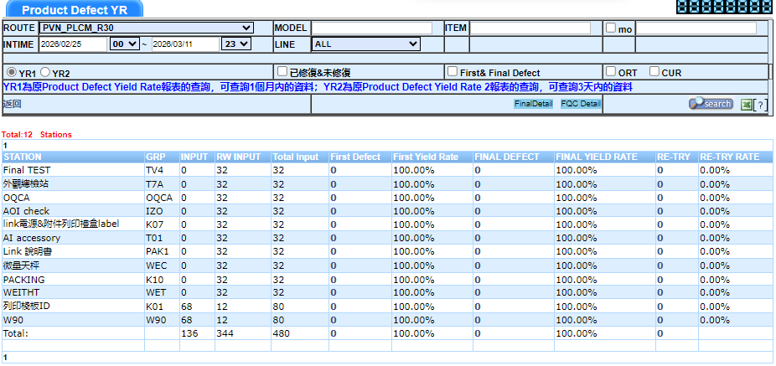
BG6
PVN
Q4 –2025 Work Results
Training on cambrain system
Checking all part of the component: label, cover, logo…
AOI ICX R30
Number of quantity checking

Slide 5
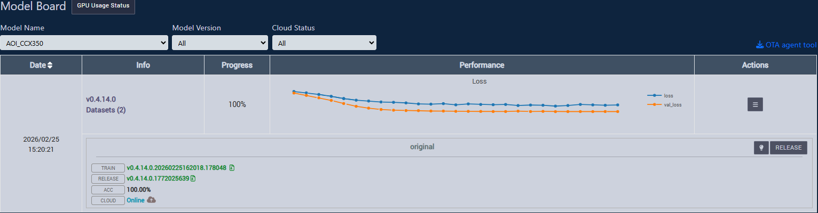
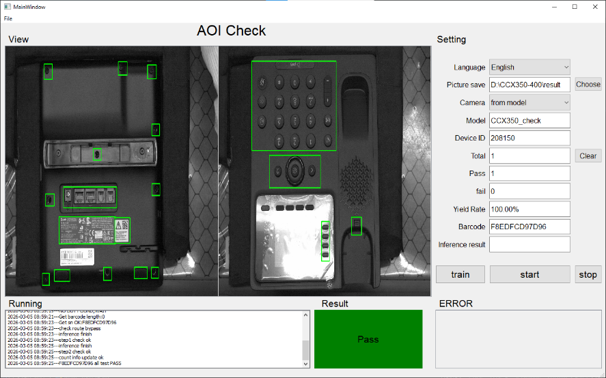
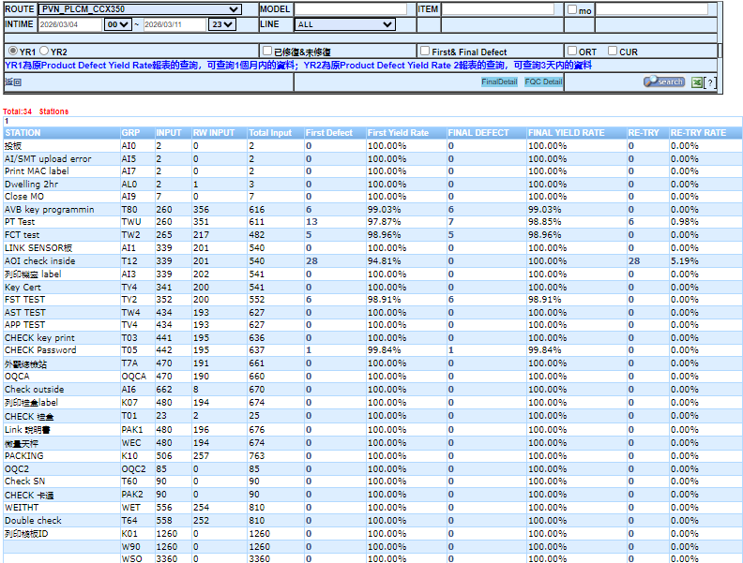
BG6
PVN
Q4 –2025 Work Results
Training on cambrain system
Checking all part of the component: net, keypad, switch, screw,….
AOI ICX CCX 350
Number of quantity checking

Slide 6

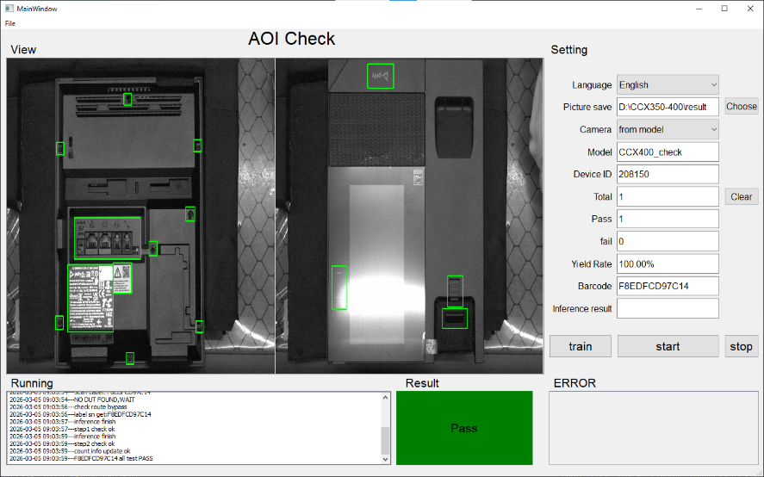
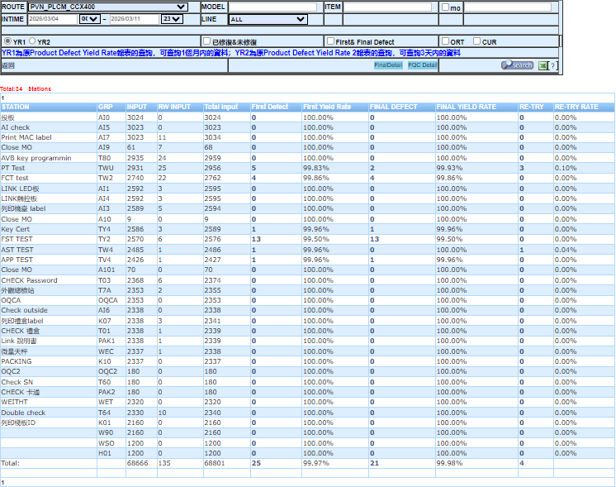
BG6
PVN
Q4 –2025 Work Results
Training on cambrain system
Checking all part of the component: screw, label, net,..
AOI ICX CCX 400
Number of quantity checking

Slide 7
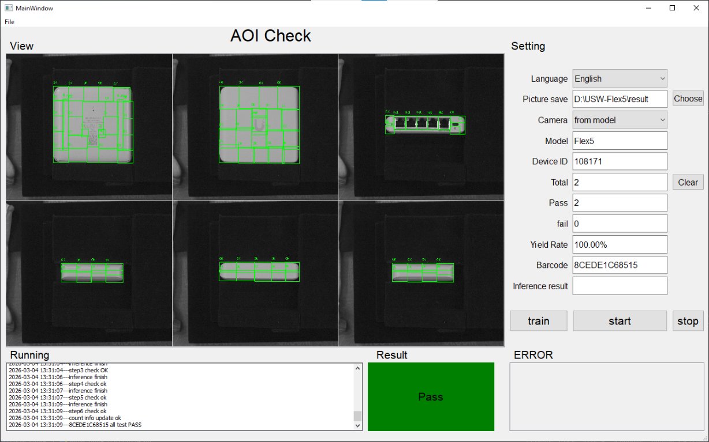
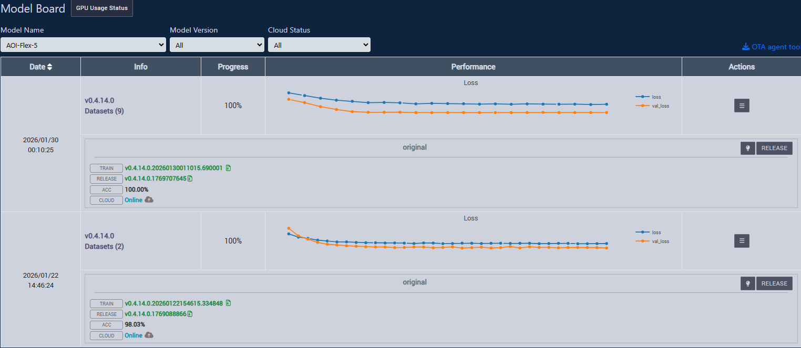
BG6
PVN
Q1 –2026 Work Results
Checking all part of the component: net, OK, …
AOI ICX Flex5
Training on cambrain system

Slide 8
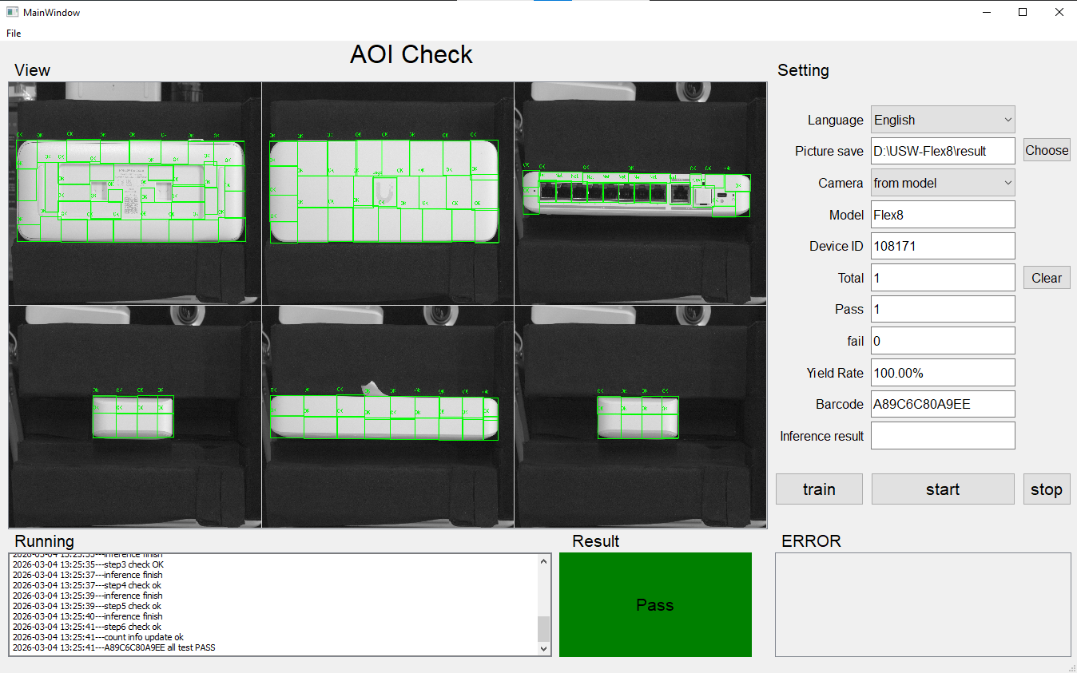
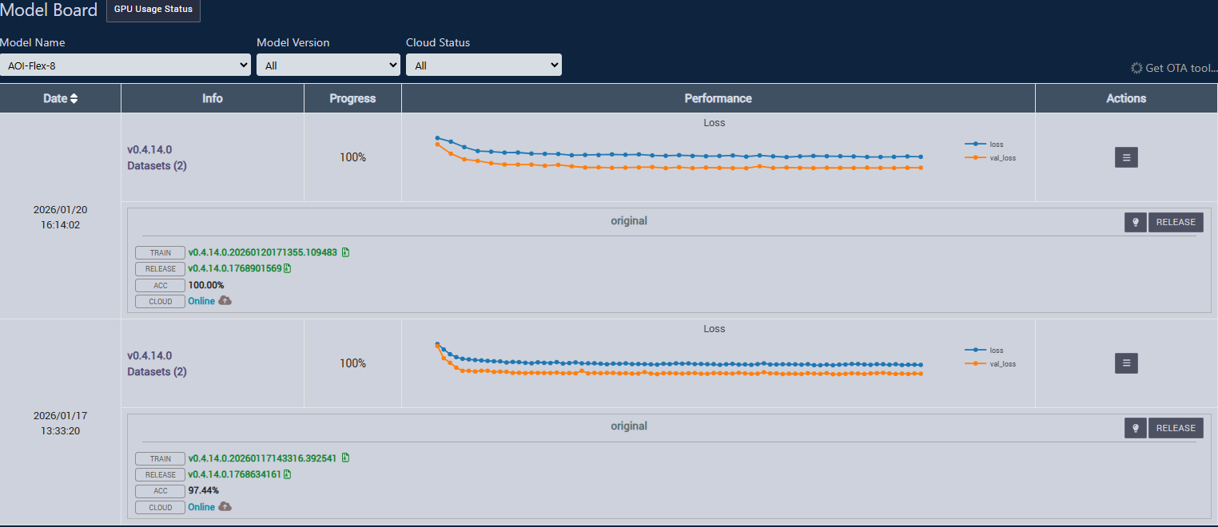
BG6
PVN
Q1 –2026 Work Results
Checking all part of the component: net, OK,…
AOI ICX Flex8
Training on cambrain system

Slide 9
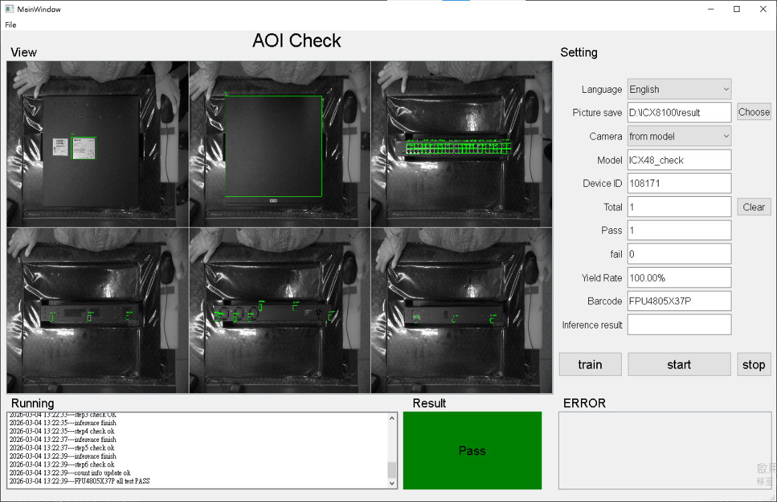
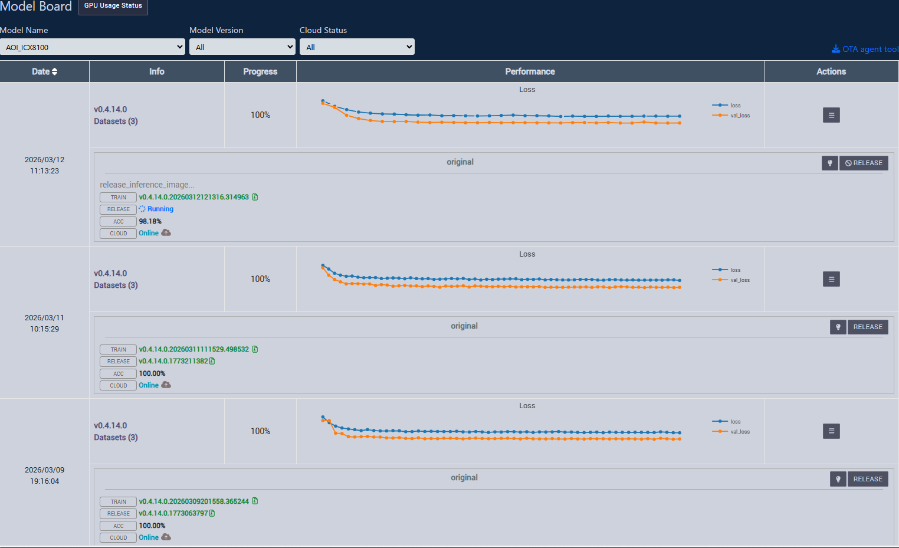
BG6
PVN
Q1 –2026 Work Results
Checking all part of the component: label, net, OK, screw,…
AOI ICX 8100
Training on cambrain system

Slide 10
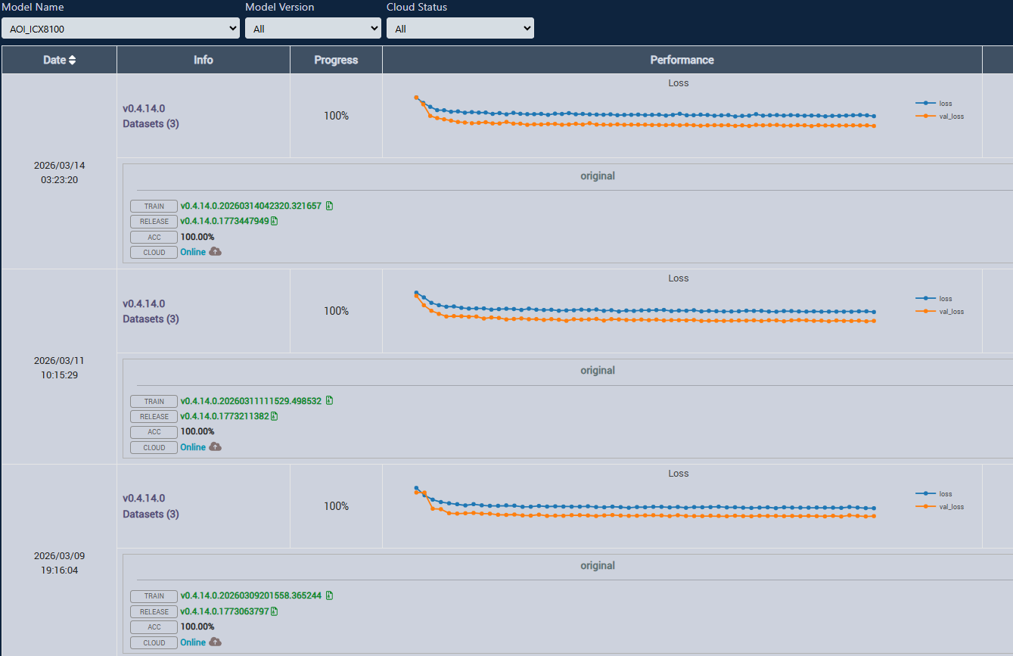
2.New model training report
Problem:
-The old version (v0.4.0.0) often appear error and take a lot of time to training
-AOI program sometime appear error when running.
Result:
-The model training accuracy to 100%
-AOI model running more effective
Solution:
- Change the new version to (v0.4.14.0)
New version training
Old version training

Slide 11
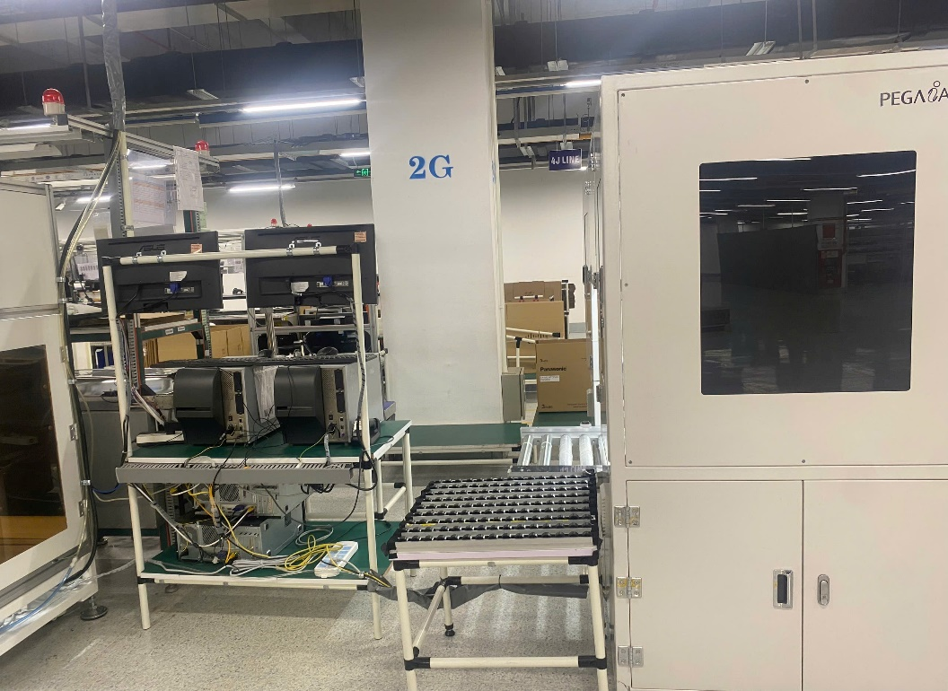
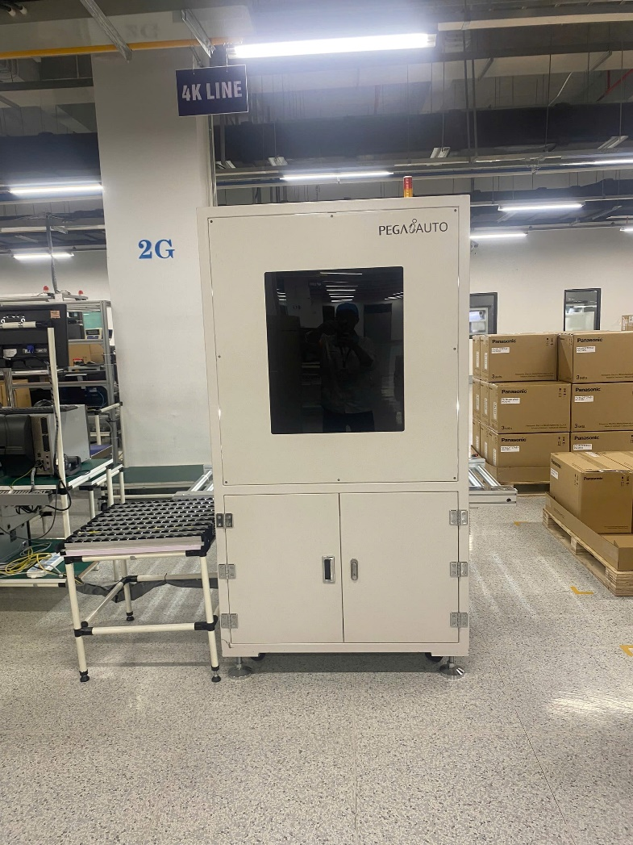
3. AOI 4K Panasonic Carton change position
IE have plan AOI Panasonic carton change position
1.Change AOI Carton position go to left about 80 cm
2.Set up sfis line, camera, PC, led light, power outlet.

Slide 12
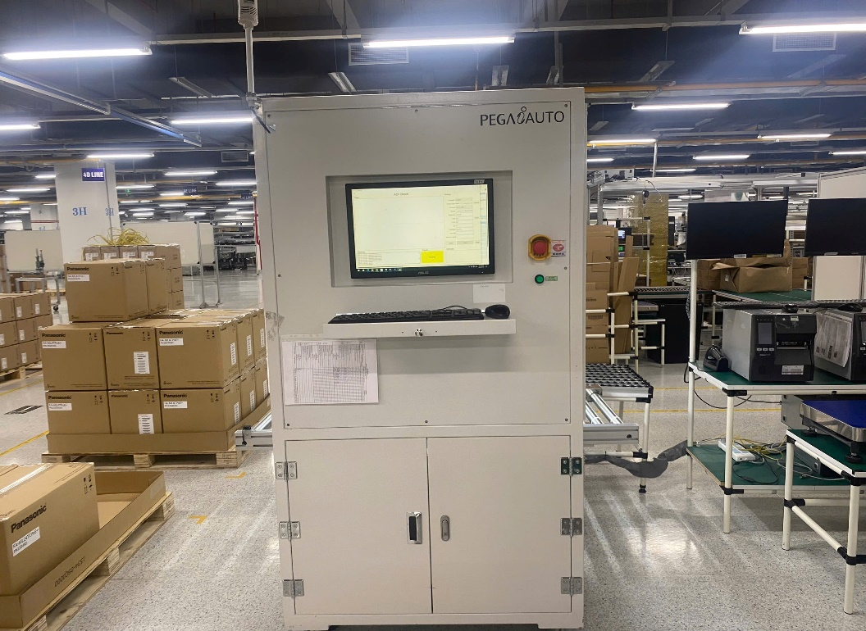
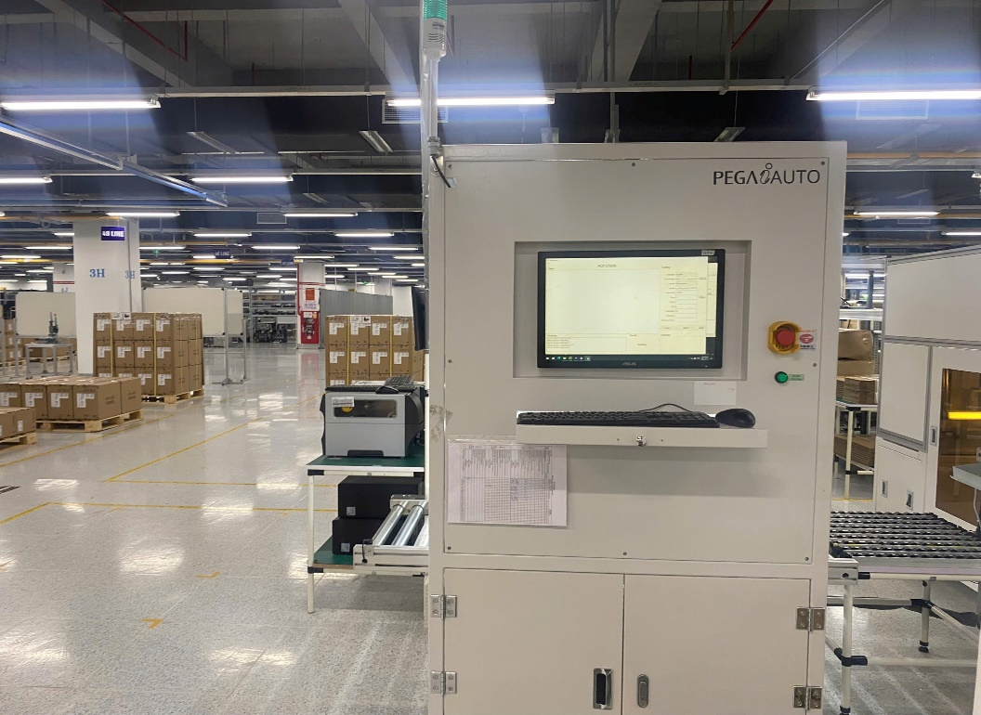
3. AOI 4K Panasonic Carton change position
Old position
New position

Slide 13

BG6
PVN
2025 Q3 Work and Self-development plan achievement rate
2025 Q3 Work and Self-development plan | Achievement rate | The reason | The plan for completion
1. Continue flow-up AOI device on production line | 90%
2. Improve the performance of AOI device | 90%
3. Improve coding skills to debug, optimize the AOI program | 70% | AOI programs using Python ,C/C#.I need to learn more about to understand how it works and debug when it appear error. | - Reading program code to understand. - Practice debug code.
4. Continue learning Chinese (HK1, HK2) for improve communication skills . | 30% | I started learning HK1 lately because the course not enough member | - Learning HK1 and HK2 more diligence

Slide 14
BG6
PVN
PVN Future work and Self-Development Plans
Time | Future work
2026 Q2~ | 1. Continue flow-up AOI device on production line
 | 2. Improve the performance of AOI device (above 95%)
 | 3. Report errors on the device and find solutions
 | 4. Improve coding skills to debug, optimize the AOI program
 | Work and Self-Development Plans
 | 1. Improve coding skills : JavaScript, ChatGPT AI, C/C#….
 | 2. Continue learning Chinese (HK2, HK3) for improve communication skills .
 | 3. Working more efficiency with team member
 | 4. Improve English communication skills to improve work efficiency.
FME
BG6 PVN

Slide 15
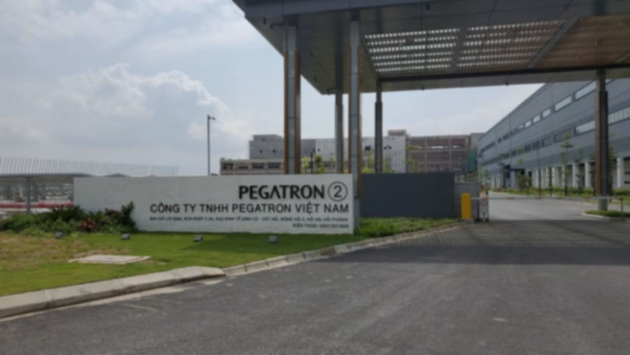
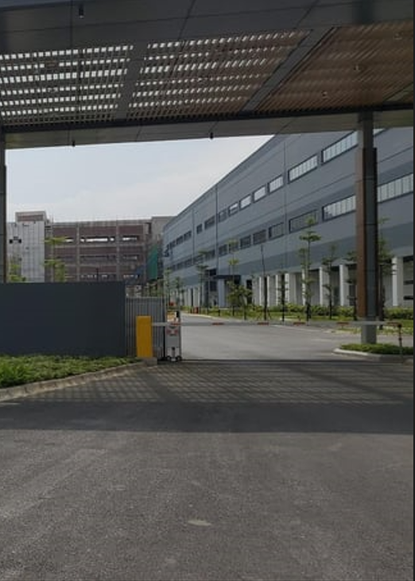
Thank You

